Slide 1

Final Design Review
Team Members:
Steffen Damm steffendamm@mines.edu
Adam Houghtaling ahoughtaling@mines.edu
Matt Lange mlange@mines.edu
Mark McNulty markmcnulty@mines.edu
Victoria Polda vpolda@mines.edu
Zachary Steenson zsteenson@mines.edu
Faculty Adviser: Dr. Arkadan aaarkadan@mines.edu
Technical Advisor: Dr. Coulston coulston@mines.edu
1

Slide 2
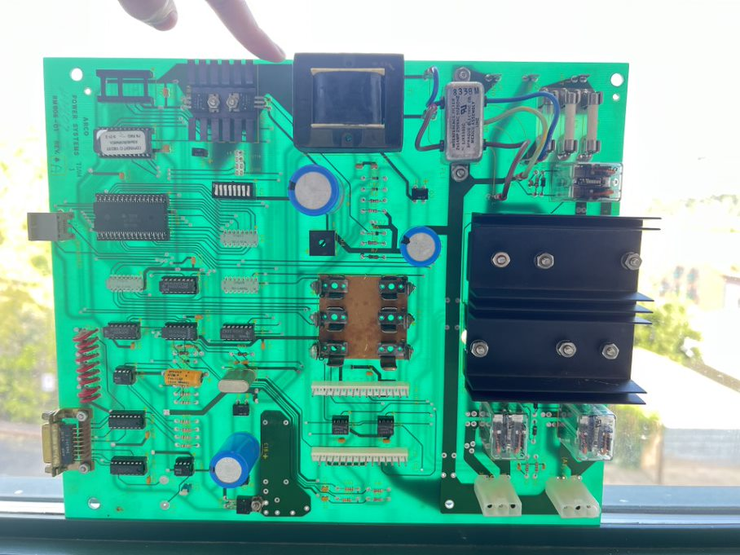
Problem Statement
Two-Axis Tracker is 30 Years Old, Relies on Outdated Hardware and Software
Hardware Lacks Documentation and Flexibility Modern Components Allow
Software Written in Fortran & Running on DOS, Not Optimal for Modern Day
Existing Controls System Board
Notes:
The problem statement for this project is that NREL’s two-axis tracker is 30 years old, and relies on hardware and software that is outdated.
This is a problem, because this old hardware is lacking in both documentation and flexibility compared to modern components.
Current needs a DOS emulator to run FORTRAN code, need physical cable to connect to system

Slide 3
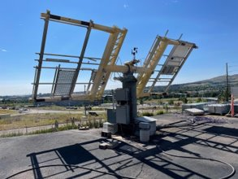
Goals
Reverse Engineer and Design a System to replace existing control system for Two-Axis Tracker
Must Control Two 90V DC Motors Controlling Azimuth and Elevation Directions
Apply Modern Hardware, Software, and GUI for Inputs and Outputs
NREL's 2-Axis Tracker
Notes:
So, the goals for this project is to design a new system to replace the existing one for the Two-Axis Tracker.
As this is two-axis tracking, this system must be able to control two 90V DC motors, controlling both azimuth and elevation.
This new system should be utilizing modern hardware components, modern programming languages, as well as have a graphical user interface to handle inputs and outputs.

Slide 4
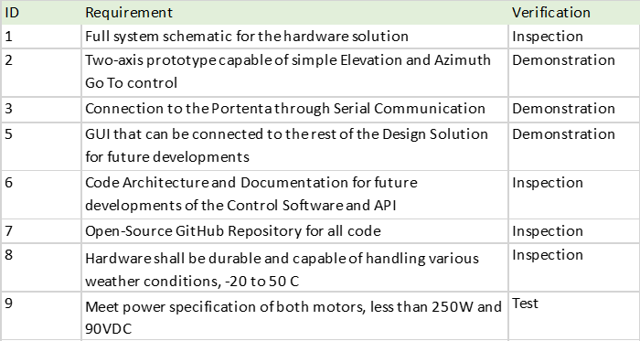
Project Requirements
Notes:
And here we have the requirements for the project, …

Slide 5
System Overview (Black Box)
Time of Day
Tracker Location
Controller
End-stops
Power to Motors
User Control (GUI)
Power
Hall Sensor Feedback
Notes:
This is the high-level overview of the basic functionality of the what the controller is doing
The controller takes inputs of Time of day and the coordinates of the tracker to find the location of the sun in terms of azimuth and elevation relative to the tracker
User control to determine what the tracker is doing: heliostat, sun track, and GoTo
And overall, the power to power the entire system
Then you have the controller which takes these inputs on the left and determines the output to send to the motors to achieve the desired position based on the feedback of the motors internal hall sensors.

Slide 6
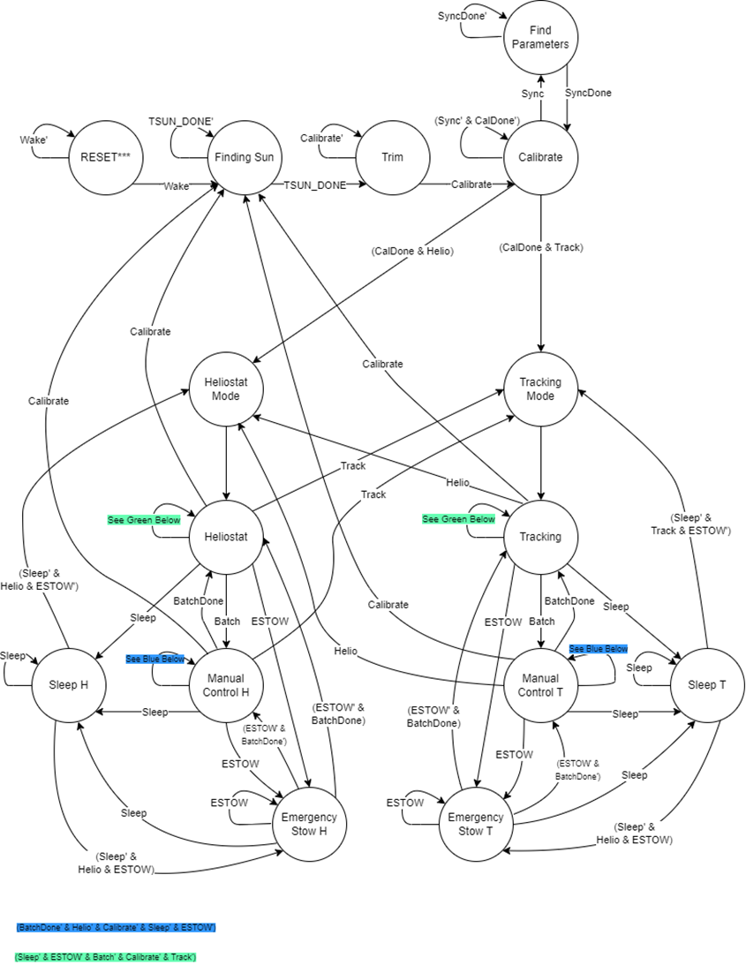
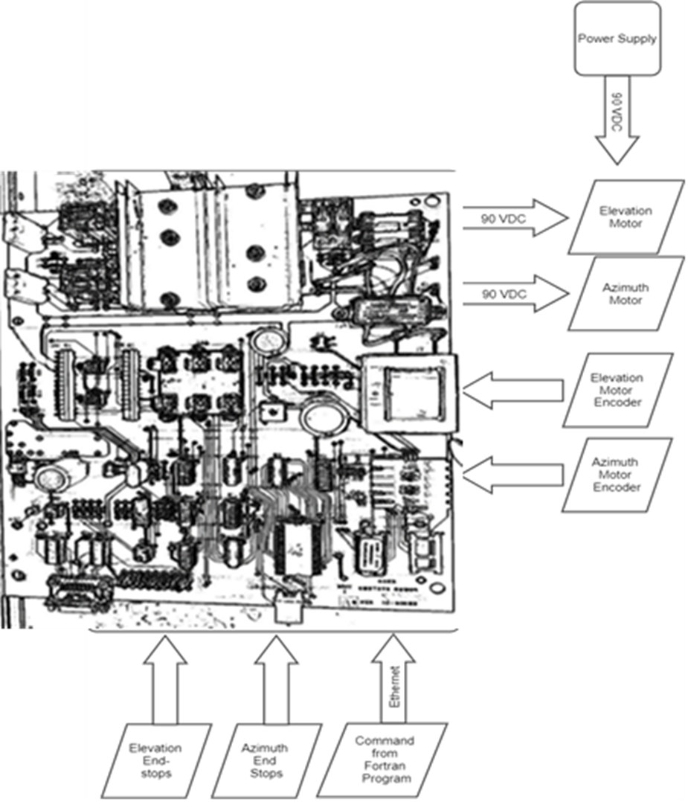
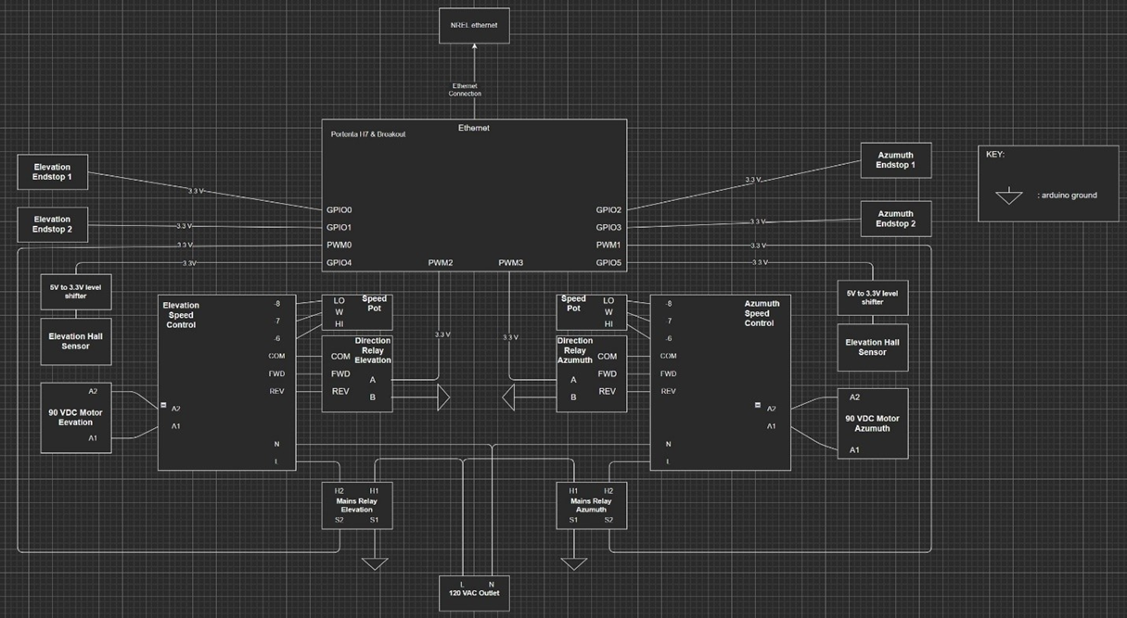
Initial Design Exploration
FPGA
Board Rebuild
Design New PCB with Modern Components
FPGA Control Unit
Implement Field Programable Gate Array for Hardware and Software Control
Microcontroller Control Unit
Implement New Control Hardware and Software Utilizing a Microcontroller for Control of Two Axis Tracker.
Board Rebuild
Microcontroller
Notes:
When we set out to accomplish the project goals, we determined that there are three potential routes that would satisfy the project goals and requirements.
These we’re the
Board rebuild – Read description – however doesn’t fully accomplish the goal of modernize the design with a new programming language and thus didn’t get selected
FPGA Control Unit – read description – but increases the programming complexity immensely for the benefit of speed which wasn’t needed for the project requirements
microcontroller control unit. – read description – which was selected because it completely satisfied all the goals and requirements notably with the least mount of complexity compared to the other two

Slide 7
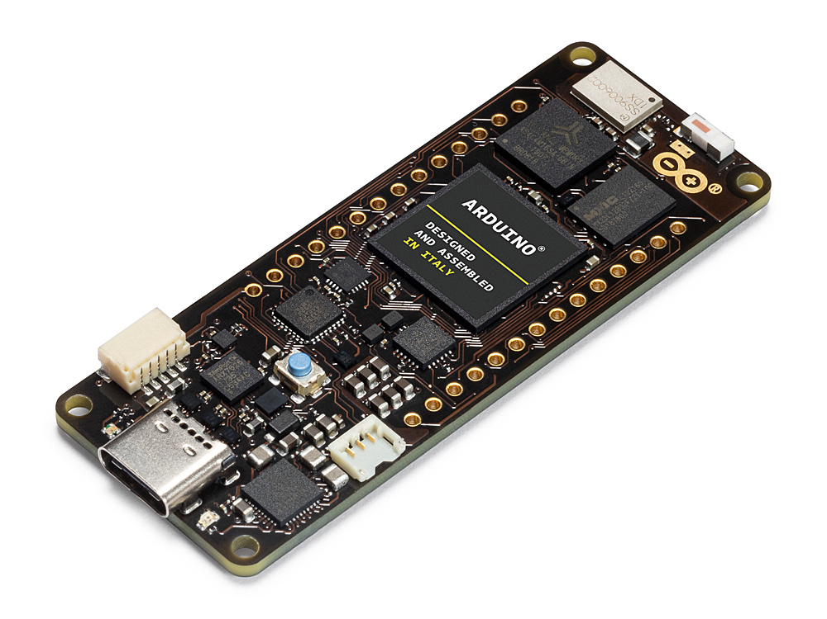
Microcontroller Selection
Microcontroller Selected Based on 5V rails, Network capability, programming Language, Memory, Speed, Age
Based on Criteria, Portenta H7 Was the Best Solution Due to Its
Network capable: WIFI and Ethernet
Speed: Dual Core & 240 MHz Clk
Native MicroPython Environment
Notes:
Next after determining what solution, we would take to accomplish the goals and requirements we needed to select the best microcontroller for the projects goals and requirements.
We determined that specifically we needed a 5V rail for the motors internal hall sensor, network capable allowing for remote control through the local network, and micropython capabilities. There were other factors when comparing microcontrollers that set each of them apart such as memory, speed, and age.
From these factors we found that the Portenta H7 fit these requirements the best with the notable capabilities of WIFI and Ethernet high speed with Two cores allowing for two similtanius processes and wopping 240 MHz clk and its native to MicroPython.

Slide 8
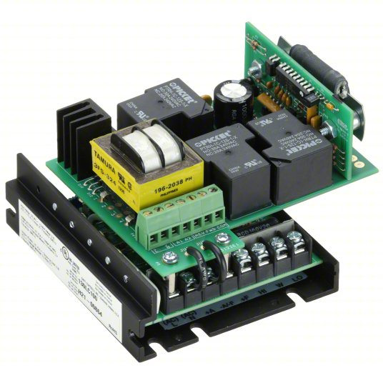
Motor Drive Solution
Tracker Motor Control
90 VDC
Direction Control
Speed Controller Was Selected Based on
Cost
Implementation Complexity
Notes:
The next main piece of hardware that the team needed to make a decision about was how we were going to drive the 90 VDC motors with a control voltage of 3.3 V. For this we needed to be able to drive the motors at 90 VDC as well as switch the direction of motor rotation. The team came up with two potential solutions for these criteria a homemade solution using Solid state relays in an h bridge configuration or a speed control. Ultimately the speed controller was selected because of the cheapness of Speed controllers compared to 4 SSR and the Implementation Complexity of using a speed controller with a microcontroller vs with an H-bridge.

Slide 9
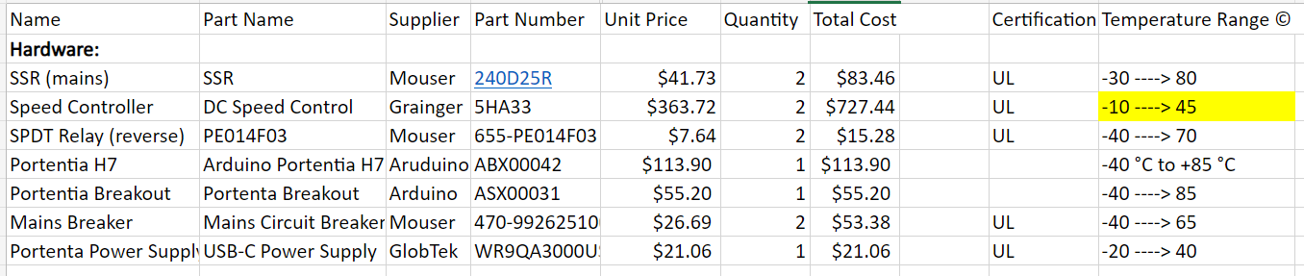
Bill of Materials
Notes:
SSR: corresponds to the "TurnOn" helper function, that when triggered, delivers input power to the speed controller which then gives 90 volts to the motor.
Speed Controller: Previously mentioned
Single Pole Double Throw Relay: Controls the direction of the motor by providing a signal to either the FWD or REV terminal of the speed controller.
Portenta H7: Previously mentioned
Portenta Breakout: Allows access to each of the Portenta pins through header pins for wiring.
Mains Breaker: Turns the circuit On/Off and protects from any overcurrent possibilities.
Portenta Power Supply: Gives Portenta power

Slide 10
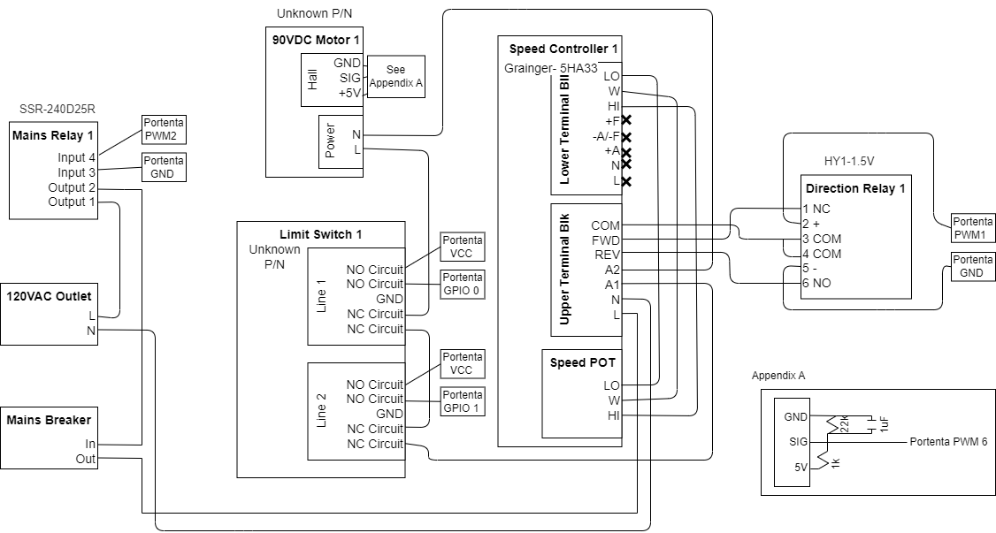
Circuit Diagram (One Axis)
Notes:
From left to right,
Mains Relay is controlled by PWM pins that close a circuit delivering the 120V AC from the outlet to the input side of the Speed Controller.
Two limit switches put in series that have two triggers for each switch. The initial trigger is NO and is sent VCC on one side while we constantly monitor the other side to see if the switch closes, telling the controller that the limit switch has been hit. The second trigger is NC and is the hardware failsafe to protect the tracker, where if this condition is met, the power circuit is opened stopping the motor's motion.
The Speed Controller is controlled by a voltage control knob, and a direction relay which flips its polarity based on the direction of motion. This takes the input AC voltage and outputs 90V DC to the motor.
Lastly, the Appendix corresponds to the Hall Sensor of the motor which is directly mirrored from the existing tracker hall sensor circuit with the addition of a 1uF capacitor used to filter out noise.

Slide 11
Hardware Build-Up
Determined Pinouts for the End Stop Circuits​
Designated GPIO Pins for Each Subsystems​
Created Test Script to Verify Feedback From Hall Sensor​
Verified Speed Controller Output​
Verified Relay Control for Mains and Direction​
Subsystem Integration once Each Was Verified​
Used Five Rotation in Each Direction Loop to Prove Full Control
Notes:
This details how we carried out our incremental testing build-up.
Used a multimeter to determine how each of the circuits in the limit switches were related and their corresponding pinouts.
Designated each of the controls for the subsystems to GPIO pins to relate the hardware to our code.
Created testing scripts to see the feedback from the hall sensor based on motor movement.
Tested speed controller by supplying it AC voltage and adjusting the variable voltage control to see the change in output voltage.
Tested the outputs of both relays to verify on/off control and direction control
Once each piece of hardware was tested, we then wired each of them together and used a five rotation loop in each direction to prove full control before then expanding on our controller code.

Slide 12
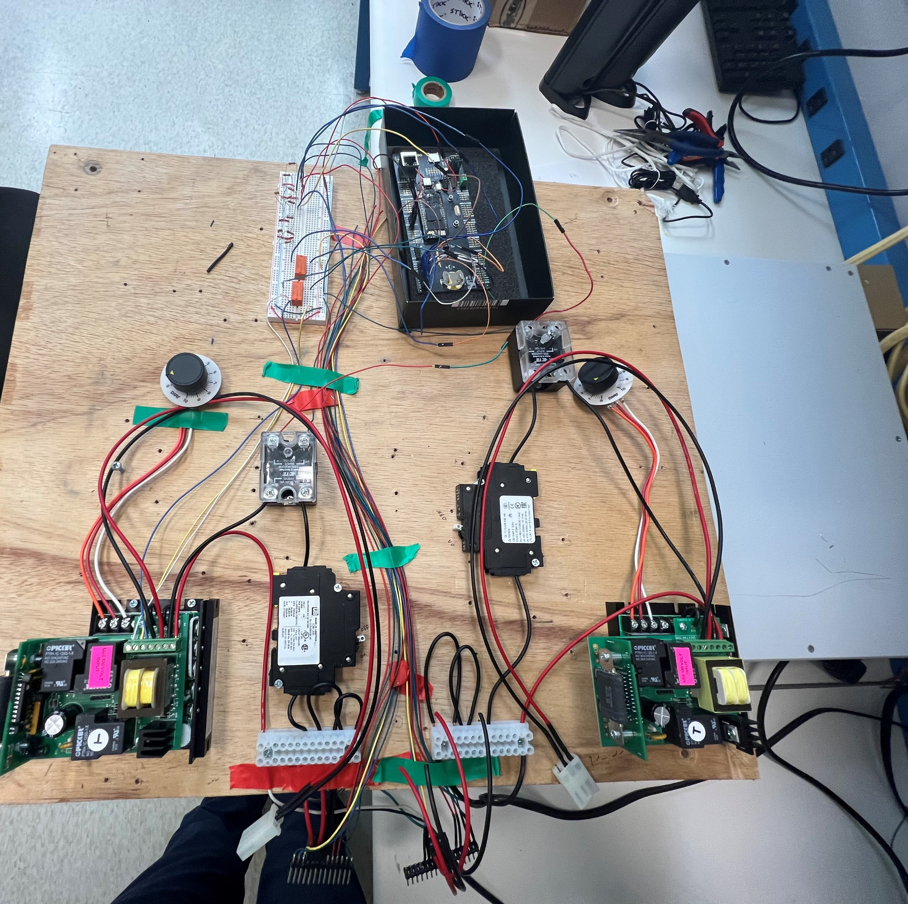
Test Bed
Full Test Setup of Two-Axis Control Prototype Through the Development of System Test Bed.
Notes:
Show each hardware piece in front of them then begin the Go To Demo.

Slide 13
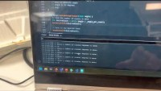
Go To Demonstration

Slide 14
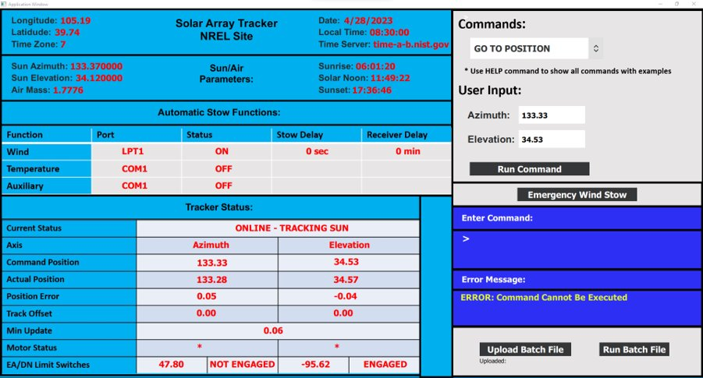
GUI
Notes:
Graphical User Interface Contains All Parameters and Necessary Buttons
Drop Down Menu Includes Most Common Commands: Go To Position, Heliostat, Track Sun, Halt, Wind Stow, etc.
All other Commands can be entered manually as before
Data is gathered from the API, continually updated from calculations within controller
Buttons Have python functions associated with them, ease of transition to integrated system
Repository with GUI set up to work, virtual environment set up with batch file as long as requirements are met

Slide 15
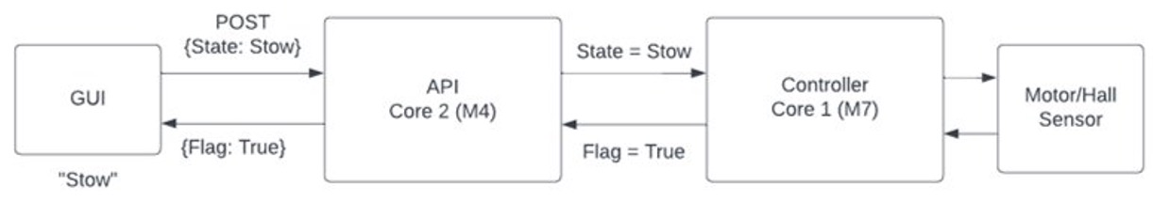
API
An API is Necessary for Remote Communication Between Devices
They Allow for Different Applications to Communicate Through a Custom Set of Rules
This Was Needed to Allows the GUI to Communicate with the Control Software and Motors
Python
C++
Notes:
As we developed the GUI, we realized we would need an API for our design. API stands for "Application Programming Interface". An API is a set of protocols, routines, and tools for building software applications. They define how software components should interact and communicate with each other, providing a standardized way for developers to integrate functionality from one application into another.
This was necessary for our project as an Api is needed in order to allow for the python based GUI hosted on a webserver to communicate with the C based controller software. The API would act as a translator between the two by running a web server that takes and accepts requests from both ends.
This can be seen in the Example diagram here. The GUI would send a JSON packet of the user input to the API hosted on one core of the portenta. It would then write the appropriate variables to the memory shared between the cores. While doing this, it would then pull every one second from the controller all relevant data to be displayed along with if the user inputted state had been reached as seen with the flag Boolean. The API would then write an HTML webpage file that could be sent to the user to be displayed on their end on the GUI.

Slide 16
API Design Selection
Initial Solutions Considered
Final Design Solution
HTTP server Hosted on Hardware
Webserver Hosted Remotely
Data Transmission Formats
JSON, MessagePack, Custom
Data Logging
Narrowed Down Scope to Consist of Serial User Interface
Cross Core Communication
Starting Point for Future API
Notes:
As we begun to attempt to design the API, we realized just how many different options were available to us.
Such included where to host the API. The main options were on hardware like the Portenta or an RPI, or through a paid service on the cloud or a server hosted on an NREL server.
We also looked into different protocols for data transmission such as JSON, MessagePack, or writing our own.
Logging to an external database was also investigated along with a simple data log file.
We now realize we should have communicated directly with the client on what they wanted instead of continuing to explore these options.
For our Final Design, we greatly narrowed down the scope of the API portion. This meant focusing on building a Serial Interface to allow user interaction without the already designed GUI. Another aspect focused on was that of the cross core Communciation on the Portenta. This included a table of variables that each core could reference and update. This will be shown on the next slide. And we hopefully will provide a starting point for future API developments on the project.

Slide 17
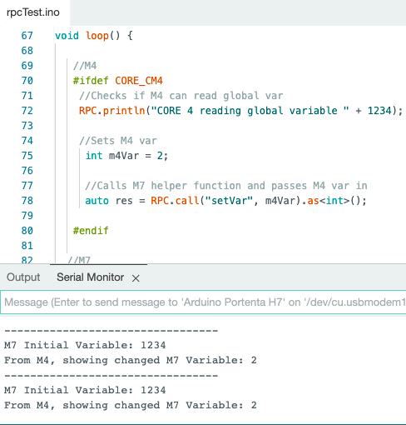
API Challenges and Successes
Two Cores:
Accepting Commands while Printing Data
Navigating Serial Monitor Sending and Receiving Commands
Language Integration for Microcontroller
Cross Core Communication
Notes:
Encountered challenges and successes from investigating API design. After looking into software, the serial output experienced a challenge of simultaneously accepting and sending commands. Along with this, we encountered challenges integrating Micropython language into the Arduino microcontroller H7. The software design did have success communicating between the two cores on the Portenta H7, which will be useful for memory allocation for hardware and streaming interface. [talking about two cores screenshot]

Slide 18
Broader Impacts
Scope of the Two-Axis Tracker Impacts the Current Solar Panel in NREL, its Employees
Current Design Interface and Hardware Control are Configured for the Specific Tracker. Future Implementation for Design Team and Project
Notes:
-Scope of projects will impact a few different clients
-NREL employees
-Future tracker implementation and design team [starting framework of hardware and code]

Slide 19
Lessons Learned
Professional
Communication
Ask Questions Promptly
Inform Client Consistently
Managing Expectations
Analyze Scope and Schedule
Estimate Time
Teamwork
Verify Work with Team
Technical
Engineering Process
Iterative schedule
Requirements, BOM, Decision Matrices
Software Design
Backend development and API
Hardware Design
Debugging and Testing
Notes:
This Project has provided us plenty of opportunity for lessons learned in both Professional and Technical aspects.
In terms of Professional, Communication proved to be the most vital and challenging. We now know to ask questions promptly and to prioritize direct communication of our design with the Client.
Along with communication, we learned more about how to manage our own and the clients expectations. We wish we had invested more time into accurately estimating and planning for each portion of the project. Such as getting outside estimates on how long certain developments would take, for example developing a webserver on a Portenta.
In order to maintain a schedule, having the team demonstrate and explain their work to other subsections of the team helped debugging as well our understanding of the Project.
In terms of Technical, this project gave us insight into a real world engineering process. Such as aspects like iterative design, debugging, and maintaining a schedule. It allowed up to apply engineering principles like requirements, Bill of materials and decision matrices.
On the software side, we learned about how a user interface connects with a backend via an API. This involved exploring many different ideas as mentioned before. We also learned about how language selection affects library availability and community support.
For the hardware side, we struggled to estimate just how long it would take to debug and test our setup. In the future, we would allocate more time to the debugging and testing side.
Overall, this project was a great opportunity for all of us to grow as engineers

Slide 20
Future Work
GUI
Connect with API
Fill out Button Functions
Updating Properties
API
Support Communication Between H7 and User Device via Webserver
Constant Data Stream
Controller
Integrate and Test Translated Functions with Hardware Setup
Hardware
Further Testing
Fully Set up DIN Rail Mounting to Configure to NREL System
Notes:
GUI:
Connect With API
Able to push and pull data packages and commands to API
Controller:
Translated Functions: Heliostat, TrackSun
Won’t Work until API is Connected

Slide 21
Thank you Questions?
21

